Slide 1


Machine Downtime
NAME
AKSHAT SRIVASTAVA
PROFILE
LinkedIn –
https://www.linkedin.com/in/akshat-srivastava-ak47/
GitHub –
https://github.com/Akshat-ak47/
PROJECT NAME
GUIDED BY -
Mr. Amarender Reddy Gundumalla
ROLE
Data analysis

Slide 2






Contents
Project Architecture
Business Problem
Business Objective
Project Overview
Data Dictionary
Exploratory Data Analysis
Data Pre-processing
Data Visualization
Notes:
Change

Slide 3
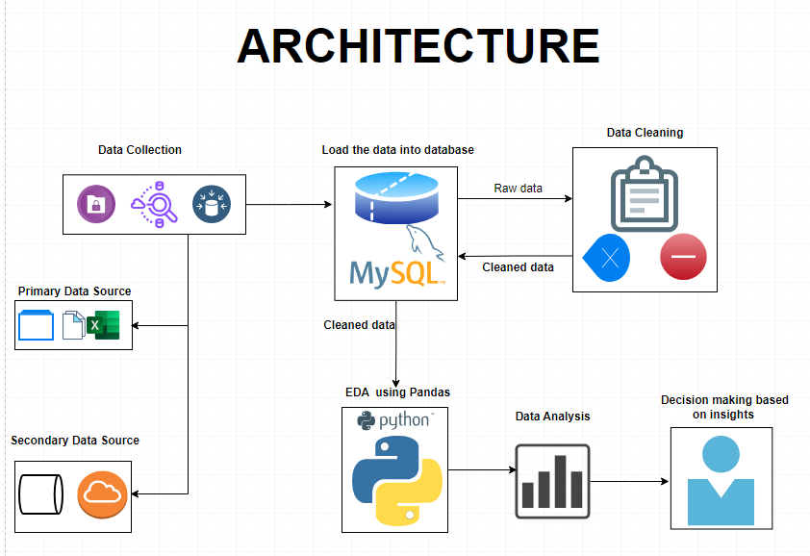
PROJECT ARCHITECTURE

Slide 4

Business Problem
Manufacturing pumps involves various machines and processes, which are critical for the production process. Unplanned machine downtime in a pump manufacturing facility can have significant negative consequences for productivity, cost-efficiency, and overall operations.
The main business problem is as follow:
a. Machine which manufacture pumps
b. Unplanned Machine Downtime which is leading to loss in productivity
c. Productivity Impact: Reduced Production Output
d. Operational Costs: Increased expenses from repair and maintenance
f. Quality Issues: Defects in machine and its parts

Slide 5
BUSINESS OBJECTIVE
Objective
Constraints
Minimize maintenance cost.
It is a crucial goal for any organization, as it can lead to increased operational efficiency and cost savings. To achieve this, you can implement several strategies and best practices
1. Minimize unplanned machine downtime is the main business objective.
2. This indicates the low business and production that leads to the loss of organization.

Slide 6
PROJECT OVERVIEW & SCOPE
The project involves working with a leading vehicle fuel pump manufacturer to address a critical business problem. The primary issue at hand is unplanned machine downtime in the manufacturing process, which is adversely affecting productivity. Machine downtime can disrupt the production process, result in loss of output, and increase maintenance costs. The client's business objective is to minimize unplanned machine downtime while also keeping maintenance costs in check.
Scope of the Project:
Client and Business Problem
Data Analysis
Data Preprocessing
Data Exploration Correlation Analysis
Feature Engineering
Recommendations
6

Slide 7
Data dictionary
Features | Data Type | Description
Date | Date | Date of the record
Machine_ID | String | Machine Identifier
Assembly_Line_No | String | Assembly line Identifier
Hydraulic_Pressure(bar) | Float | Hydraulic pressure in bar
Coolant_Pressure(bar) | Float | Coolant pressure in bar
Air_System_Pressure(bar) | Float | Air system pressure in bar
Coolant_Temperature | Float | Temperature of the coolant
Hydraulic_Oil_Temperature(°C) | Float | Temperature of the hydraulic oil in Celsius
Spindle_Bearing_Temperature(°C) | Float | Temperature of the spindle bearing in Celsius
Spindle_Vibration(µm) | Float | Spindle vibration in micrometers
Tool_Vibration(µm) | Float | Tool vibration in micrometers
Spindle_Speed(RPM) | Integer | Spindle speed in revolutions per minute
Voltage(volts) | Integer | Voltage in volts
Torque(Nm) | FLoat | Torque in Newton meters
Cutting(kN) | FLoat | Cutting force in kiloNewtons
Downtime | String | Status of the machine

Slide 8
Exploratory data analysis (Eda)
Statistical Insights
Business Insights
The code calculates the –
1st Business Moment: Measure Of Central Tendency
mean, median, mode 2nd Business Moment: Measure Of Dispersion
Variance, standard deviation, max, min,
3rd & 4th Moment Business Decision
skewness values, kurtosis values
These values provide summary statistics for the dataset. The code is available both in SQL and Python.
Analysis is structured in a way to get a clean insights to the data, comparing values before and after data cleaning.
The business insight of this project revolves around a leading vehicle fuel pump manufacturer's goal to minimize unplanned machine downtime in their production process while simultaneously minimizing maintenance costs.
The key insights and objectives are as follows:
Minimize Unplanned Machine Downtime:
Cost Saving:
Data-Driven Decision-Making:
Machine Health Monitoring:
Predictive Maintenance
Correlation Analysis:
Visualization
Feature Engineering:
Notes:
EDA is used for seeing what the data can tell us before the modeling task.
Change

Slide 9
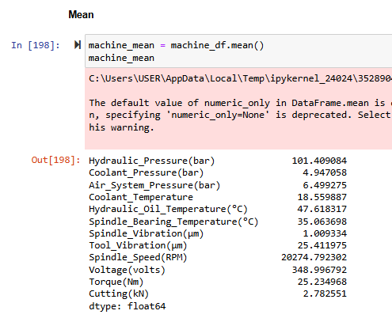
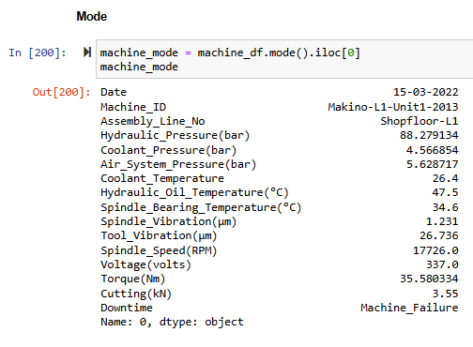
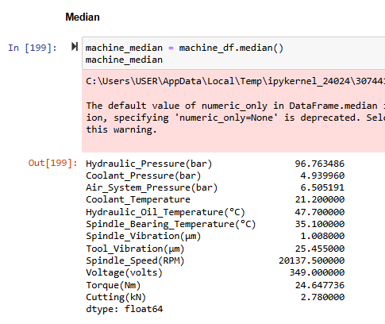
1st Business Moment: Measure Of Central Tendency

Slide 10
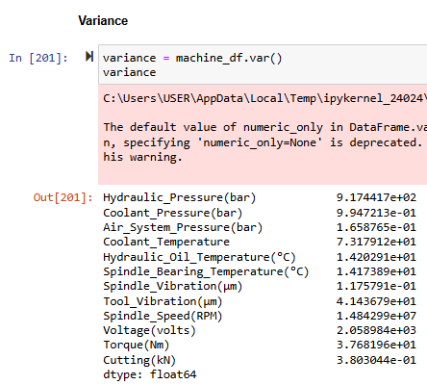
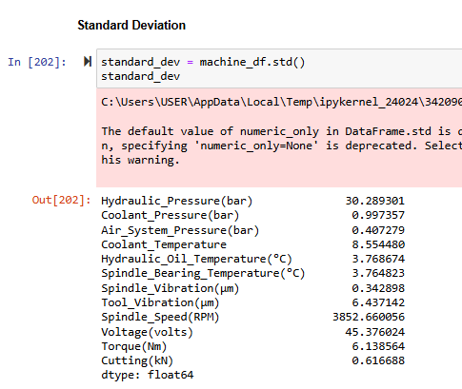
2nd Business Moment: Measure Of Dispersion

Slide 11
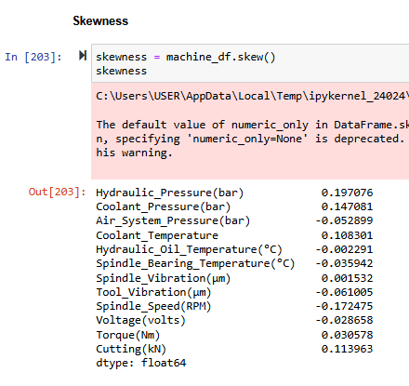
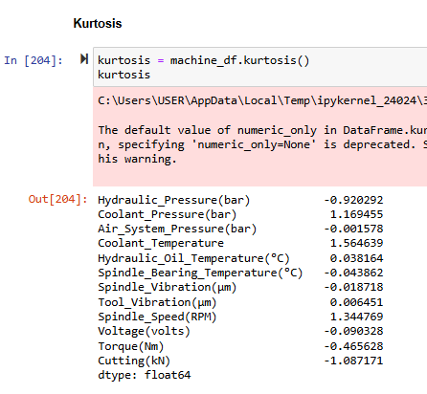
Third & Fourth Moment Business Decision

Slide 12
Data preprocessing
Data Reading:
Initially, you loaded the dataset into your environment using the pd.read_csv() function. This step is essential for bringing the data into your analysis environment, making it ready for further preprocessing and analysis.
Dataset Information:
Started by gaining an understanding of the dataset's structure and characteristics using the data.info() method. This step provided valuable insights into the data's columns, data types, and any missing values.
Descriptive Statistics:
This utilized the data.describe() method to generate summary statistics for the dataset. This allowed you to gain insights into the central tendency, dispersion, and distribution of numerical features in the data.
Duplicate Data Identification:
To ensure data integrity and consistency, identified duplicate records within the dataset using the data.duplicated() method. This step is crucial in maintaining data quality and can help in detecting and handling redundant information.
Notes:
Keep observations

Slide 13
Data visualization
The Data visualisation is the graphical representation of data to help people understand the patterns, trends, and insights within the data.
Various data visualizations are created using Seaborn and Matplotlib, such as histograms, box plots, and a heatmap of the correlation matrix. A countplot is used to visualize the distribution of the 'Downtime' variable, indicating the frequency of each category.
We have Visualize key variables, specifically Hydraulic_Pressure (measured in bar), Coolant_Pressure (measured in bar), and Air_System_Pressure (measured in bar), to gain insights and a visual understanding of their distributions and characteristics.
Notes:
Add graphical

Slide 14
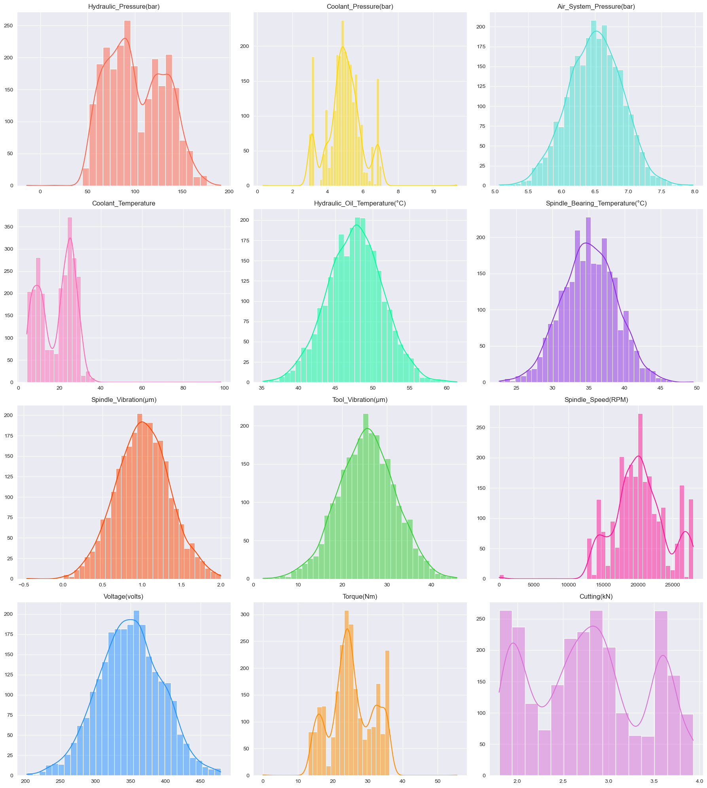
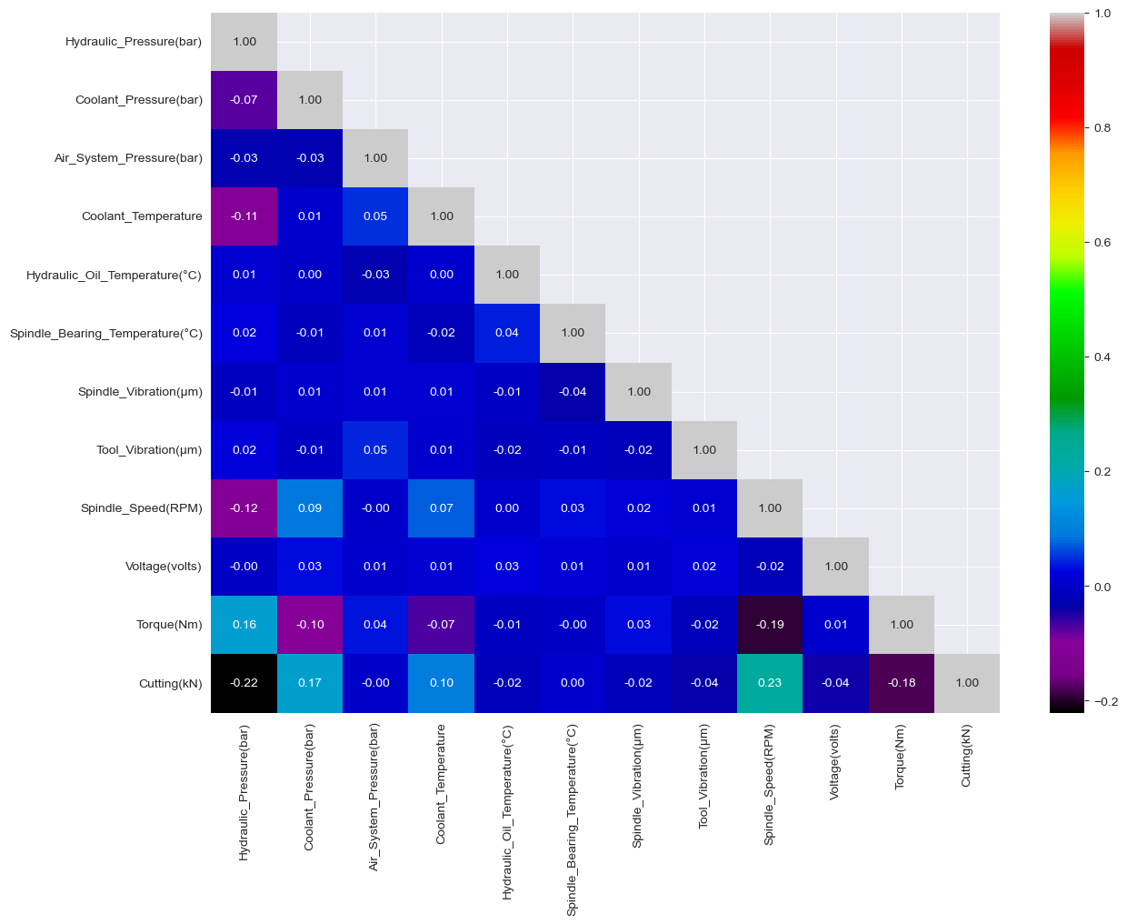
CORRELATION

Slide 15
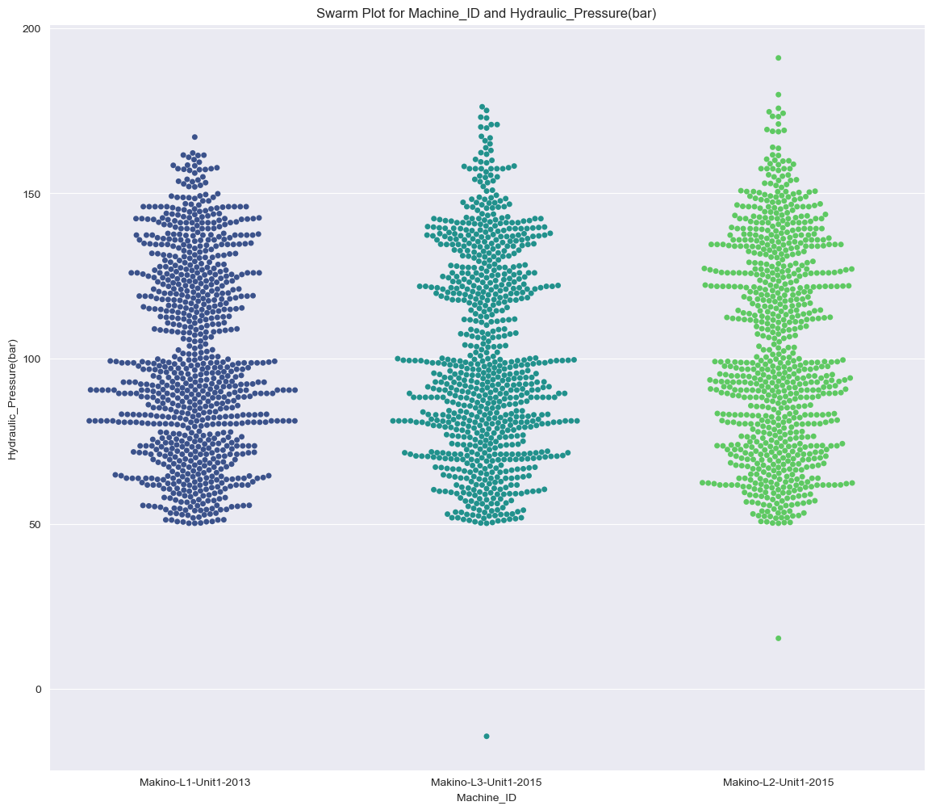
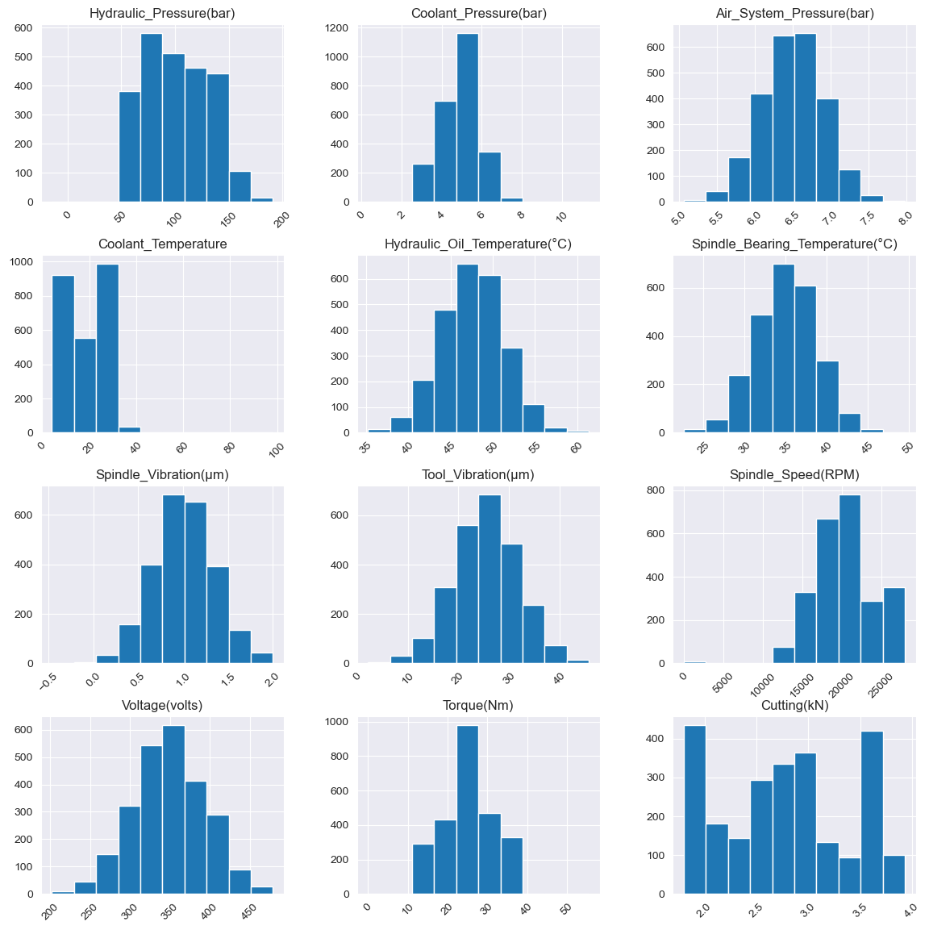
UNIVARIATE ANALYSIS

Slide 16
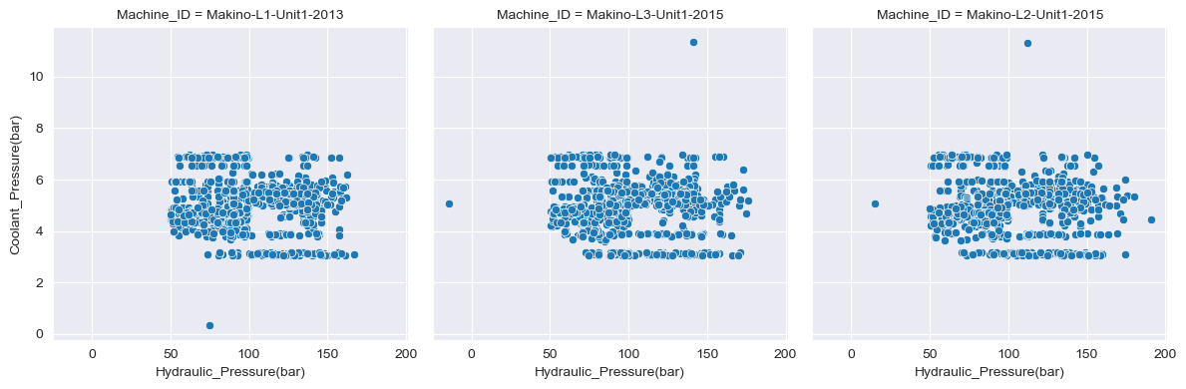
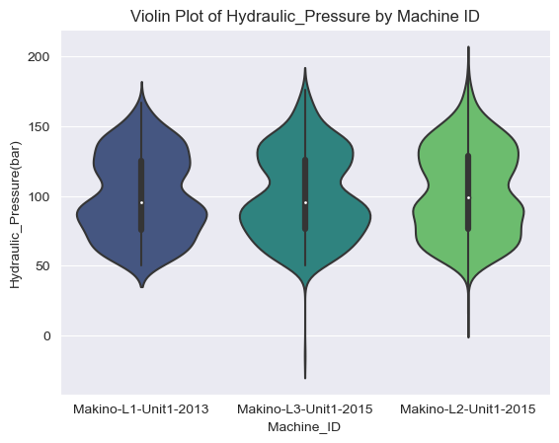
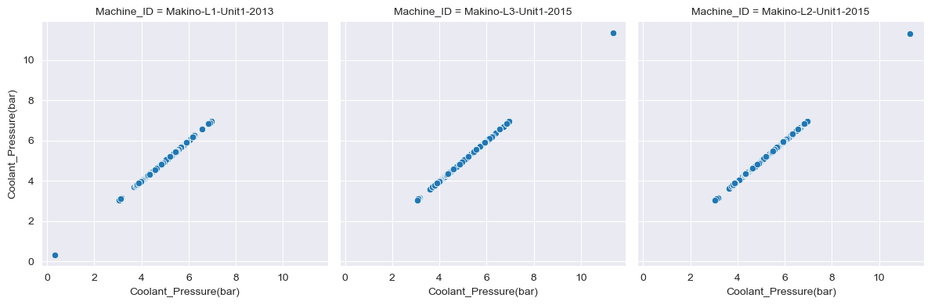
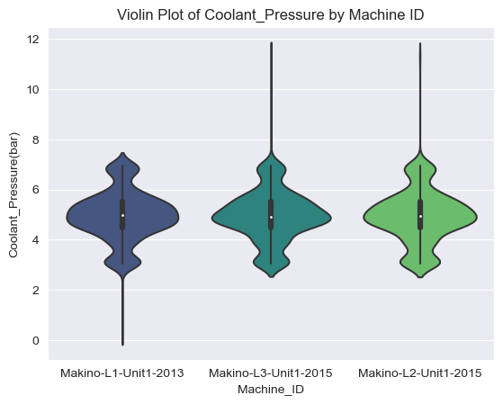
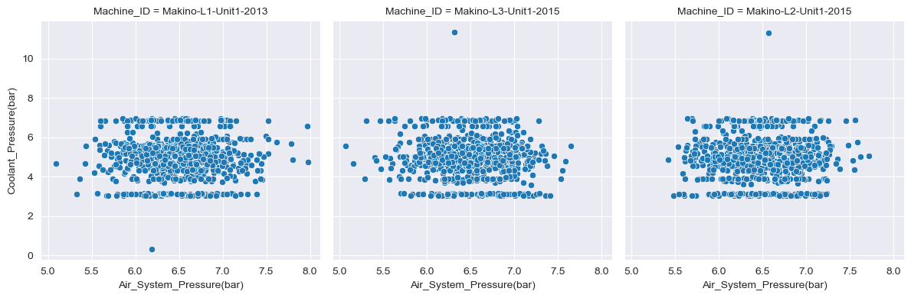
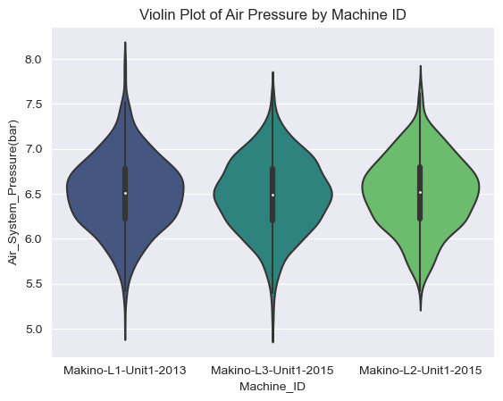

Slide 17



